Slide 1
R PROGRAMMING

Slide 2
Write a R program to take input from the user (name and age) and display the values. Also print the version of R installation
Source code
name = readline(prompt="Input your name: ")
age = readline(prompt="Input your age: ")
print(paste("My name is",name, "and I am",age ,"years old."))
print(R.version.string)
Result :
name = readline(prompt="Input your name: ")
Input your name: Hai
> age = readline(prompt="Input your age: ")
Input your age: 10
> print(paste("My name is",name, "and I am",age ,"years old."))
[1] "My name is Hai and I am 10 years old."
> print(R.version.string) [1] "R version 3.4.4 (2018-03-15)" >

Slide 3
Write a R program to create a sequence of numbers from 20 to 50 and find the mean of numbers from 20 to 60 and sum of numbers from 51 to 91.
Source code
print("Sequence of numbers from 20 to 50:")
print(seq(20,50))
print("Mean of numbers from 20 to 60:")
print(mean(20:60))
print("Sum of numbers from 51 to 91:")
print(sum(51:91))
Result :
[1] "Sequence of numbers from 20 to 50:" [1] 20 21 22 23 24 25 26 27 28 29 30 31 32 33 34 35 36 37 38 39 40 41 42 43 44 45 46 47 48 49 50
[1] "Mean of numbers from 20 to 60:"
[1] 40
[1] "Sum of numbers from 51 to 91: [1] 2911

Slide 4
Write a R program to get the first 10 Fibonacci numbers.
Source code
Fibonacci <- numeric(10)
Fibonacci[1] <- Fibonacci[2] <- 1
for (i in 3:10) Fibonacci[i] <- Fibonacci[i - 2] + Fibonacci[i - 1]
print("First 10 Fibonacci numbers:")
print(Fibonacci)
Result :
[1] "First 10 Fibonacci numbers:"
[1] 1 1 2 3 5 8 13 21 34 55

Slide 5
Write a R program to extract first 10 english letter in lower case and last 10 letters in upper case and extract letters between 22nd to 24th letters in upper case..
Source code
print("First 10 letters in lower case:")
t = head(letters, 10)
print(t) print("Last 10 letters in upper case:")
t = tail(LETTERS, 10) print(t)
print("Letters between 22nd to 24th letters in upper case:")
e = tail(LETTERS[22:24])
print(e) Copy
Result :
[1] "First 10 letters in lower case:" [1] "a" "b" "c" "d" "e" "f" "g" "h" "i" "j“
[1] "Last 10 letters in upper case:" [1] "Q" "R" "S" "T" "U" "V" "W" "X" "Y" "Z“
[1] "Letters between 22nd to 24th letters in upper case:" [1] "V" "W" "X"

Slide 6
Write a R program to create a sequence of numbers from 20 to 50 and find the mean of numbers from 20 to 60 and sum of numbers from 51 to 91.
Source code
print("Sequence of numbers from 20 to 50:")
print(seq(20,50))
print("Mean of numbers from 20 to 60:")
print(mean(20:60))
print("Sum of numbers from 51 to 91:")
print(sum(51:91))
Result :
[1] "Sequence of numbers from 20 to 50:" [1] 20 21 22 23 24 25 26 27 28 29 30 31 32 33 34 35 36 37 38 39 40 41 42 43 44 45 46 47 48 49 50
[1] "Mean of numbers from 20 to 60:"
[1] 40
[1] "Sum of numbers from 51 to 91: [1] 2911

Slide 7
Write a R program to find the maximum and the minimum value of a given vector.
Source code
nums = c(10, 20, 30, 40, 50, 60)
print('Original vector:')
print(nums)
print(paste("Maximum value of the said vector:",max(nums))) print(paste("Minimum value of the said vector:",min(nums)))
Result :
[1] "Original vector:" [1] 10 20 30 40 50 60
[1]"Maximum value of the said vector: 60"
[1] "Minimum value of the said vector: 10"

Slide 8
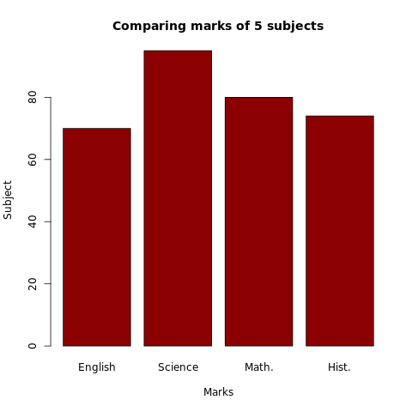
Write a R program to create a simple bar plot of five subjects marks.
Source code
marks = c(70, 95, 80, 74)
barplot(marks,
main = "Comparing marks of 5 subjects",
xlab = "Marks", ylab = "Subject",
names.arg = c("English", "Science", "Math.", "Hist."),
col = "darkred", horiz = FALSE)
Result :

Slide 9
Write a R program to find the factors of a given number.
Source code
print_factors = function(n)
{
print(paste("The factors of",n,"are:"))
for(i in 1:n)
{
if((n %% i) == 0)
{
print(i)
}
}
}
print_factors(4)
print_factors(7)
print_factors(12)
Result :
[1] "The factors of 4 are:" [1] 1 [1] 2 [1] 4
[1] "The factors of 7 are:" [1] 1 [1] 7
[1] "The factors of 12 are:" [1] 1 [1] 2 [1] 3 [1] 4 [1] 6 [1] 12

